Slide 1
Random Video Chat Website
Tianyu Yang, Yizhou Li, Bula Ha, Zeng Lin

Slide 2
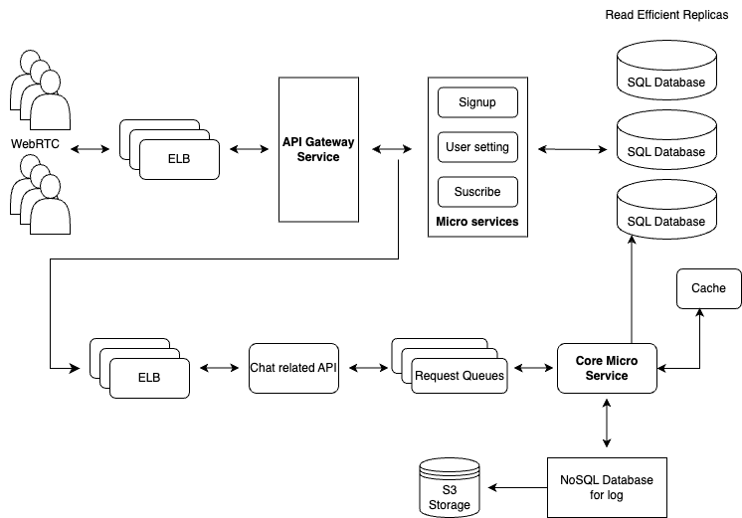

Slide 3
1.
2.
Design &
Tradeoff
3.
4.

Slide 4
3.
1.
Bottleneck
Anaylsis
2.

